Slide 1

Conditional Statements (Part 1)
Alp KUT
Derya BİRANT
Kökten Ulaş BİRANT

Slide 2
OUTLINE
Conditional Statements
  IF Statement
  IF / ELSE Statement
  Nested IF / ELSE Statements
  Switch Case (next week)
Logical Operations
Statement Block
Examples

Slide 3
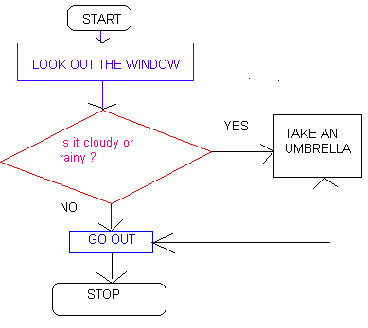
Conditional Statements
Different actions will perfom according to the condition
Example
According to the weather condition,
I will take an umbrella or not

Slide 4
IF Statement
Condition can be either true or false
Only performs an action if the condition is true
If student’s grade is greater than or equal to 60
Write “Passed”
true
write “Passed”
grade >= 60
false

Slide 5
IF/ELSE Statement
Specifies an action to be performed both when the condition is true and when it is false
If student’s grade is greater than or equal to 60
Write “Passed”
else
Write “Failed”
false
true
grade >= 60
write “Failed”
write “Passed”

Slide 6


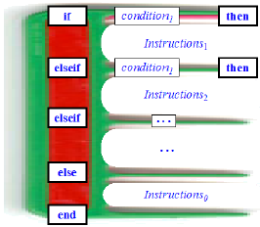
Nested IF/ELSE Statements
Test for multiple cases by placing if/else selection structures
Once condition is met, rest of statements skipped
IF condition 1 THEN
statement block 1
ELSE IF condition 2 THEN
statement block 2
ELSE IF condition 3 THEN
statement block 3
ELSE
statement block n
ENDIF

Slide 7
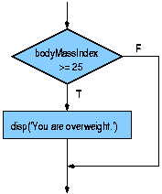
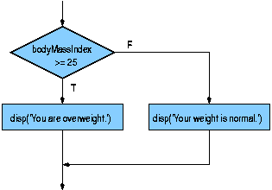
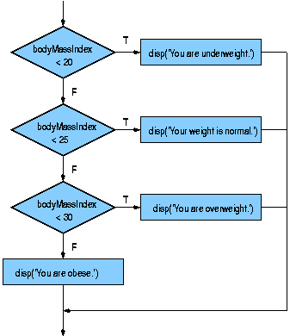
IF – IF/ELSE – NESTED IF/ELSE Statements
IF koşul THEN
[ S1 ]
END IF
If condition is true then execute S1 statement
IF koşul THEN
[ S1 ]
ELSE
[ S2 ]
END IF
If condition is true then execute S1 statement,
if not execute S2 statement
IF koşul1 THEN
[ S1 ]
ELSEIF koşul2 THEN
[ S2 ]
ELSE
[ S3 ]
END IF
If cond1 is true then execute S1
If cond1 is not true and cond2 is true then execute S2
If cond1 and cond2 are not true then execute S3

Slide 8
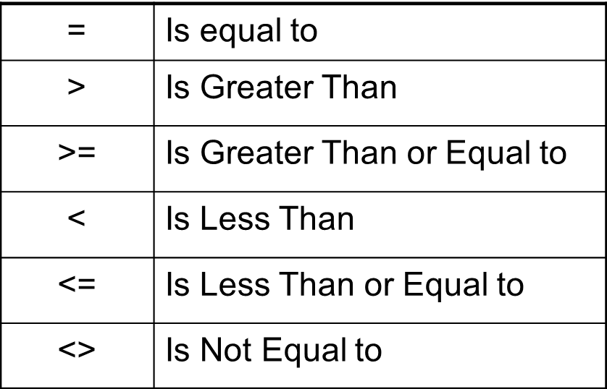
Comparison Operators
Conditions in IF statements can be formed using equality or relational operators
=
!=

Slide 9
Comparison Operators
Example | Value
if (1 + 1 == 2) | true
if (3.2 != 2.5) | true
if (10 < 5) | false
if (10 > 5) | true
if (126 <= 100) | false
if (5.0 >= 5.0) | True
if ("a" <> "c") | True
if ("a" = "a") | True
if ("a" = "A") | False

Slide 10
Example
Control the student grade
int grade;
Console.Write("Enter grade: ");
grade = Convert.ToInt32(Console.ReadLine());
if (grade >= 60)
Console.WriteLine("You passed");
true
write “Passed”
grade >= 60
false

Slide 11
Example
Control the student grade
int grade;
Console.Write("Enter grade: ");
grade = Convert.ToInt32(Console.ReadLine());
if (grade >= 60)
Console.WriteLine("You passed");
else
Console.WriteLine("You failed");
false
grade >= 60
true
write “Failed”
write “Passed”

Slide 12
Example
Find that the given number is less than, greater than or equal to 200.
Start
int number;
Console.Write("Enter a number: ");
number = Convert.ToInt32(Console.ReadLine());
if (number < 200)
Console.WriteLine("Number is less than 200");
if (number == 200)
Console.WriteLine("Number is equal to 200");
if (number > 200)
Console.WriteLine("Number is greater than 200");
Console.ReadLine();
Read Number
Number
<200?
Yes
Write “less than 200”
No
Number
=200?
Yes
Write “equal to 200”
No
Number
>200?
Yes
Write “greater than 200”
No
End

Slide 13
Example
Check a given number is even or odd
int number;
Console.Write("Enter a number: ");
number = Convert.ToInt32(Console.ReadLine());
if (number % 2 == 0)
Console.WriteLine("The number is even");
else
Console.WriteLine("The number is odd");
Console.ReadLine();

Slide 14
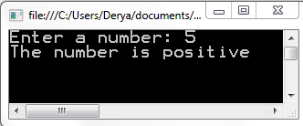
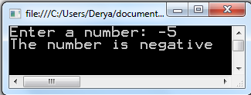
Question
Write a program that determines a given number is negative or positive.

Slide 15
Example
Take two numbers from the user and then determine which one is greater.
int number1, number2;
Console.Write("Enter the first number: ");
number1 = Convert.ToInt32(Console.ReadLine());
Console.Write("Enter the second number: ");
number2 = Convert.ToInt32(Console.ReadLine());
if (number1 > number2)
Console.WriteLine("The largest number is " + number1);
else if (number1 < number2)
Console.WriteLine("The largest number is " + number2);
else
Console.WriteLine("Equal");
Console.ReadLine();

Slide 16
Example
Write a program that prints a given digit (0-9) in English.
Example:
  Input: 3
  Output: Three
int number;
Console.WriteLine("Enter a digit (between 0 and 9)");
number = Convert.ToInt16(Console.ReadLine());
if (number = = 0)
Console.Write("Zero");
else if (number = = 1)
Console.Write("One");
else if (number = = 2)
Console.Write("Two");
else if (number = = 3)
Console.Write("Three");
else if (number = = 4)
Console.Write("Four");
else if (number = = 5)
Console.Write("Five");
else if (number = = 6)
Console.Write("Six");
else if (number = = 7)
Console.Write("Seven");
else if (number = = 8)
Console.Write("Eight");
else if (number = = 9)
Console.Write("Nine");
else
Console.Write("Error");

Slide 17
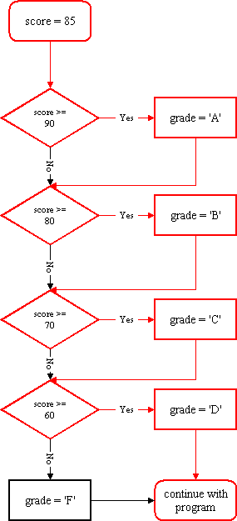
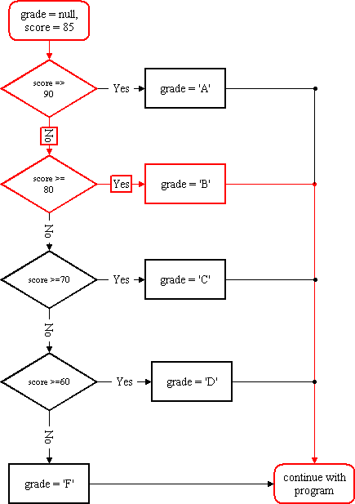
char grade;
int score = 85;
if (score >= 90)
grade = 'A';
if (score >= 80)
grade = 'B';
if (score >= 70)
grade = 'C';
if (score >= 60)
grade = 'D';
else
grade = 'F';
Console.WriteLine(" Grade: " + grade)
char grade;
int score = 85;
if (score >= 90)
grade = 'A';
else if (score >= 80)
grade = 'B';
else if (score >= 70)
grade = 'C';
else if (score >= 60)
grade = 'D';
else
grade = 'F';
Console.WriteLine(" Grade: " + grade)

Slide 18
Logical Operations
& (AND) - If all “conditions" come out true, it returns true.
| (OR) - If at least one of the “conditions" comes out true, it returns true.
! (NOT) - It reverses.
Condition1 | Condition2 | AND (Λ)
True | True | True
True | False | False
False | True | False
False | False | False
Condition1 | Condition2 | OR (ν)
True | True | True
True | False | True
False | True | True
False | False | False
Condition | NOT (┐)
True | False
False | True

Slide 19
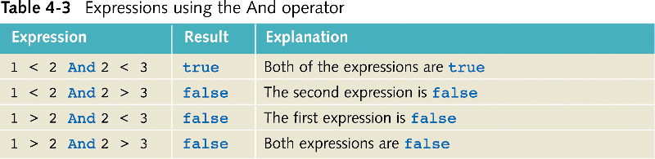
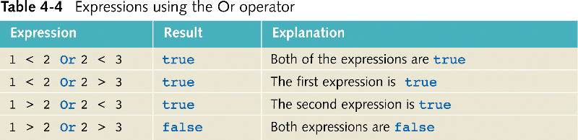
"And" vs. "Or" Operator

Slide 20
Example
Determine whether a triangle is a isosceles triangle or not.
int a, b, c;
Console.Write("Enter the first edge: ");
a = Convert.ToInt32(Console.ReadLine());
Console.Write("Enter the second edge: ");
b = Convert.ToInt32(Console.ReadLine());
Console.Write("Enter the third edge: ");
c = Convert.ToInt32(Console.ReadLine());
if (a == b)
Console.WriteLine("It is a isosceles triangle");
if (a == c)
Console.WriteLine("It is a isosceles triangle");
if (b == c)
Console.WriteLine("It is a isosceles triangle");

Slide 21
Example
Determine whether a triangle is a isosceles triangle or not.
int a, b, c;
Console.Write("Enter the first edge: ");
a = Convert.ToInt32(Console.ReadLine());
Console.Write("Enter the second edge: ");
b = Convert.ToInt32(Console.ReadLine());
Console.Write("Enter the third edge: ");
c = Convert.ToInt32(Console.ReadLine());
if ((a == b) | (a == c) | (b == c))
Console.WriteLine("It is a isosceles triangle");

Slide 22
Example
Determine whether a triangle is a equilateral triangle or not.
int a, b, c;
Console.Write("Enter the first edge: ");
a = Convert.ToInt32(Console.ReadLine());
Console.Write("Enter the second edge: ");
b = Convert.ToInt32(Console.ReadLine());
Console.Write("Enter the third edge: ");
c = Convert.ToInt32(Console.ReadLine());
if ((a == b) & (a == c) & (b == c))
Console.WriteLine("It is a equilateral triangle");

Slide 23
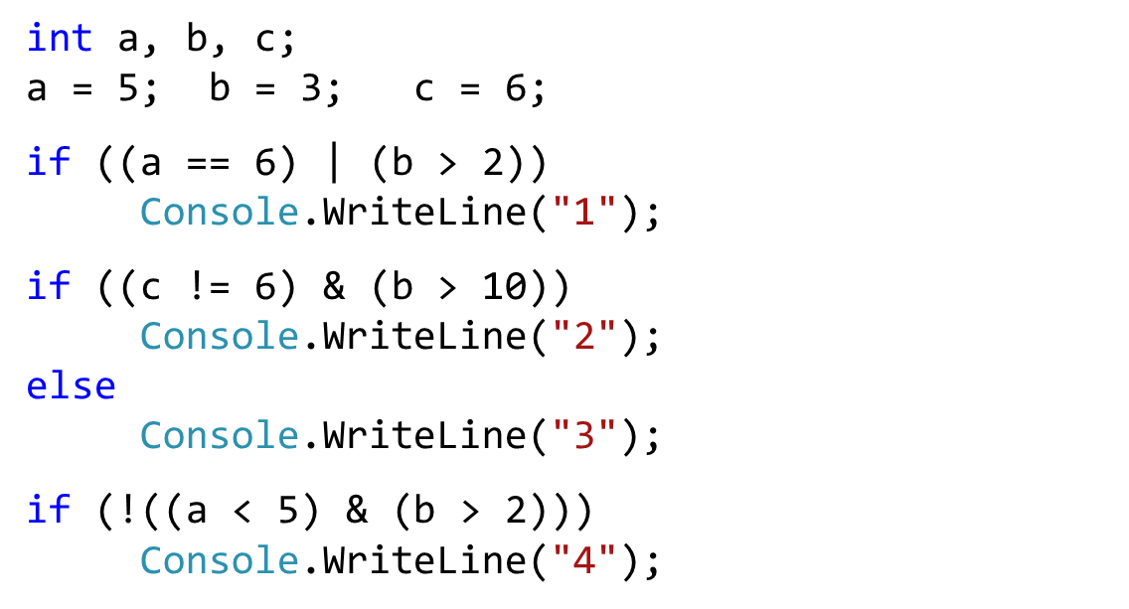
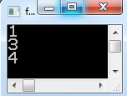
Example
What is the output of the following code?

Slide 24
Statement Block
A section of code which is grouped by braces {…}
If you write a single line, you don’t need to use braces {…}
If you write multiple lines, you must use braces {…}
int a = 1, b = 2, c = 3;
if (a == 1)
b = b + 1;
else
{
b = b + 1;
c = c + 1;
}
Single line
Multiple lines

Slide 25
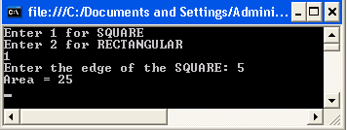
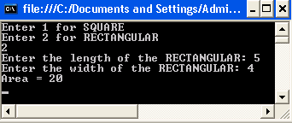
Statement Block Example
int a, b, choice, area;
Console.WriteLine("Enter 1 for SQUARE");
Console.WriteLine("Enter 2 for RECTANGULAR");
choice = Convert.ToInt32(Console.ReadLine());
if (choice == 1)
{
Console.Write("Enter the edge of the SQUARE: ");
a = Convert.ToInt32(Console.ReadLine());
area = a * a;
}
else
{
Console.Write("Enter the length of the RECTANGULAR: ");
a = Convert.ToInt32(Console.ReadLine());
Console.Write("Enter the width of the RECTANGULAR: ");
b = Convert.ToInt32(Console.ReadLine());
area = a * b;
}
Console.WriteLine("Area = " + area);
Statement Block 1
Statement Block 2

